Slide 1
Database Project: Lebanese Railways
Instructor: Mario Maroun
Done by: Hadi Dayeh, Mahmoud Farhat

Slide 2
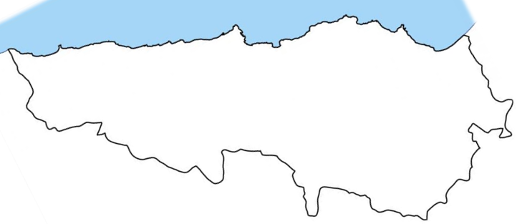
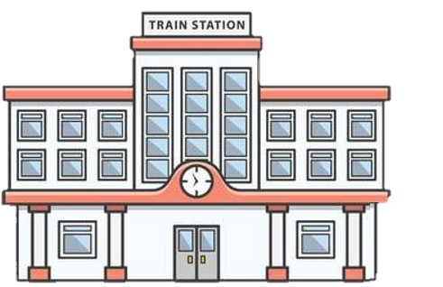
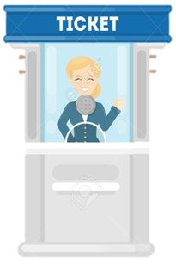

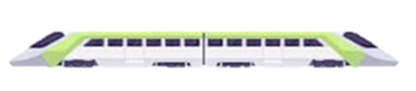
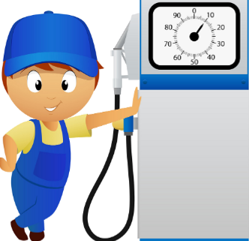






Sour
Beirut
Tripoli




Slide 3
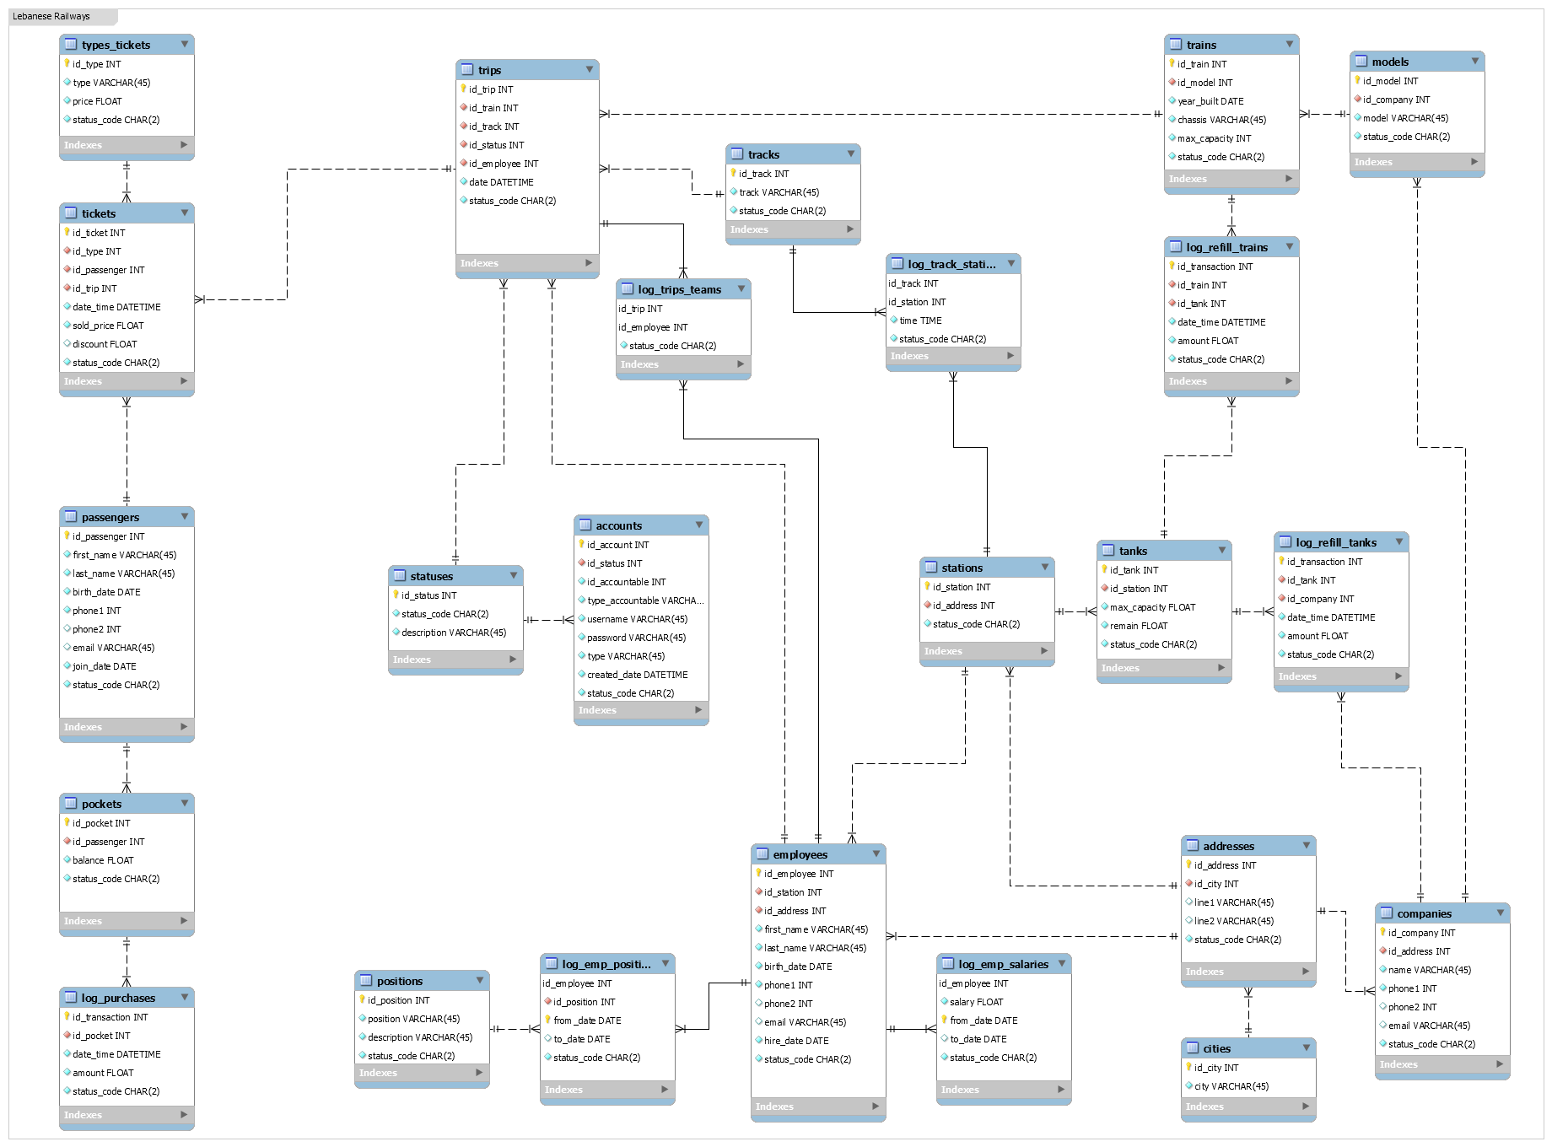





17- "Trips" are run under a schedule.
16- A "passenger" joins "trips".
15- Each "purchase transaction" should be stored.
14- A "passenger" buys a ticket.
13- "Employees", "companies", and "stations", each has an "address".
12- Each "station" has many tanks.
11- Each "train" is made by a company and has a "model".
10- Each "ticket" has a "type".
09- Each "passenger" has a "pocket" which cannot be shared.
08- Companies
07- Addresses(addresses, cities)
06- Station (stations, tanks)
05- Trains (trains, models)
04- Trips
03- Tickets (tickets, ticket_types)
02- Employees (employees, positions)
01- Passengers (passengers, pockets)
e

Slide 4
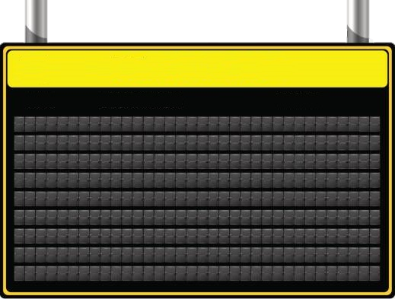
Schedule From Monday to Friday
Station Time
Sour 11:30 12:00 12:30 13:00 13:30 14:00 14:30 15:00 15:30 16:00 16:30
Beirut 12:00 12:30 13:00 13:30 14:00 14:30 15:00 15:30 16:00 16:30 17:00
Tripoli 12:30 13:00 13:30 14:00 14:30 15:00 15:30 16:00 16:30 17:00 17:30
Track 12 ..................................................................................................................................... Track 22
Sour 06:00 06:30 07:00 07:30 08:00 08:30 09:00 09:30 10:00 10:30 11:00
Beirut 06:30 07:00 07:30 08:00 08:30 09:00 09:30 10:00 10:30 11:00 11:30
Tripoli 07:00 07:30 08:00 08:30 09:00 09:30 10:00 10:30 11:00 11:30 12:00
Track 1 ....................................................................................................................................... Track 11

Slide 5
Departures (Beirut)
Trip Number Destination Departure Time Status
1 Tripoli 06:30 AM Delayed (5 Minutes)
2 Sour 06:30 AM On Time
3 Tripoli 07:00 AM On Time
4 Sour 07:00 AM Canceled
5 Tripoli 07:30 AM On Time
6 Sour 07:30 AM On Time
7 Tripoli 08:00 AM Delayed (10 Minutes)
8 Sour 08:00 AM On Time

Slide 6
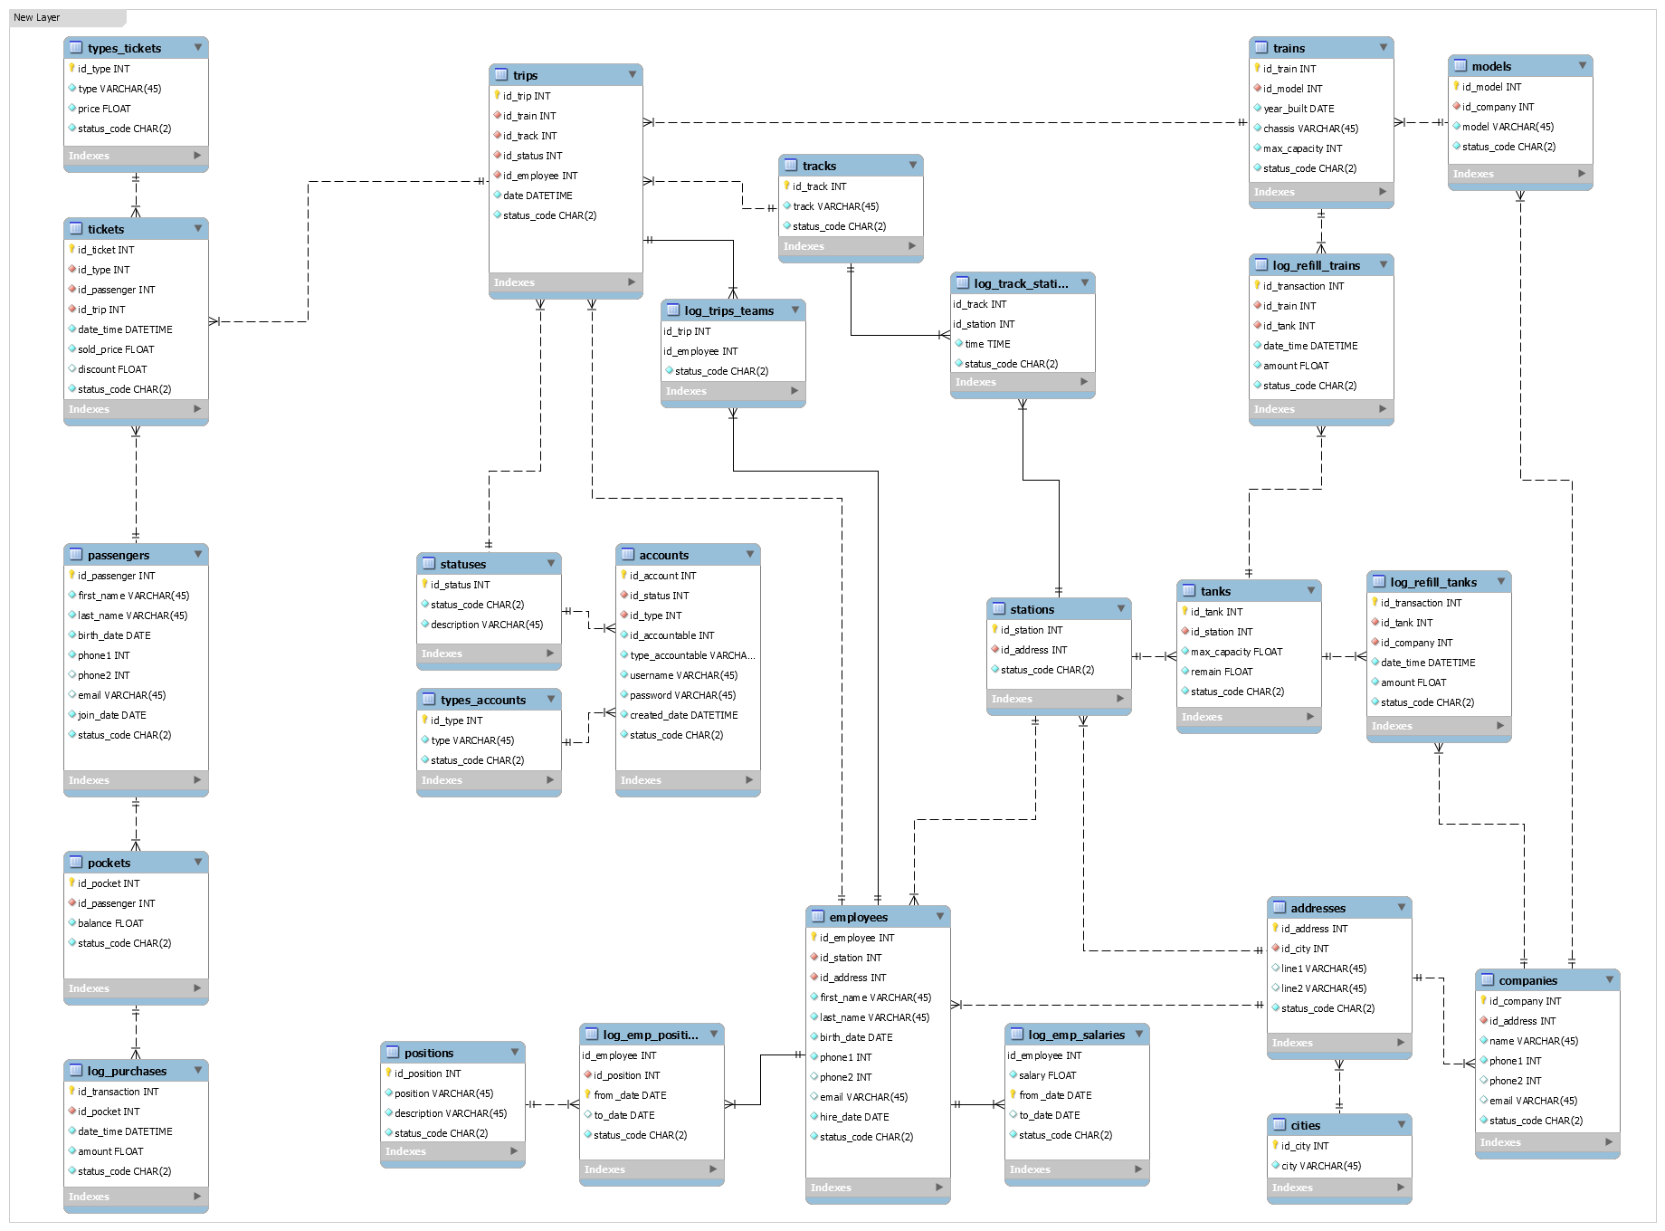

24- "Employees" and "passengers", each has an account on the system.
23- Each "employee" works at a station.
22- Each "employee" has a "position" and a salary that changes. The change history should be saved.
21- The tanks are also refilled repeatedly by outside companies.
20- All "trains" are refilled with fuel several times per day, and each refill transaction should be stored.
19- Each "trip" is run by a team of "employees" – one of them is the captain – using a train.
18- Some "trips" might be canceled or delayed. It could be also on time.
17- "Trips" are run under a schedule.

Slide 7
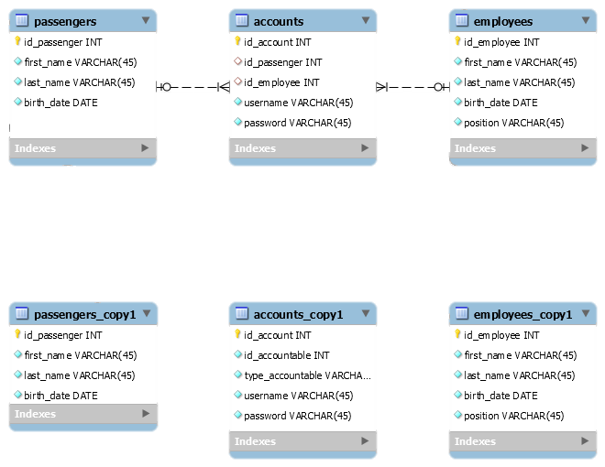

Polymorphic Relationship:
A polymorphic relationship is where an entity can belong to more than one other entity on a single association.

Slide 8
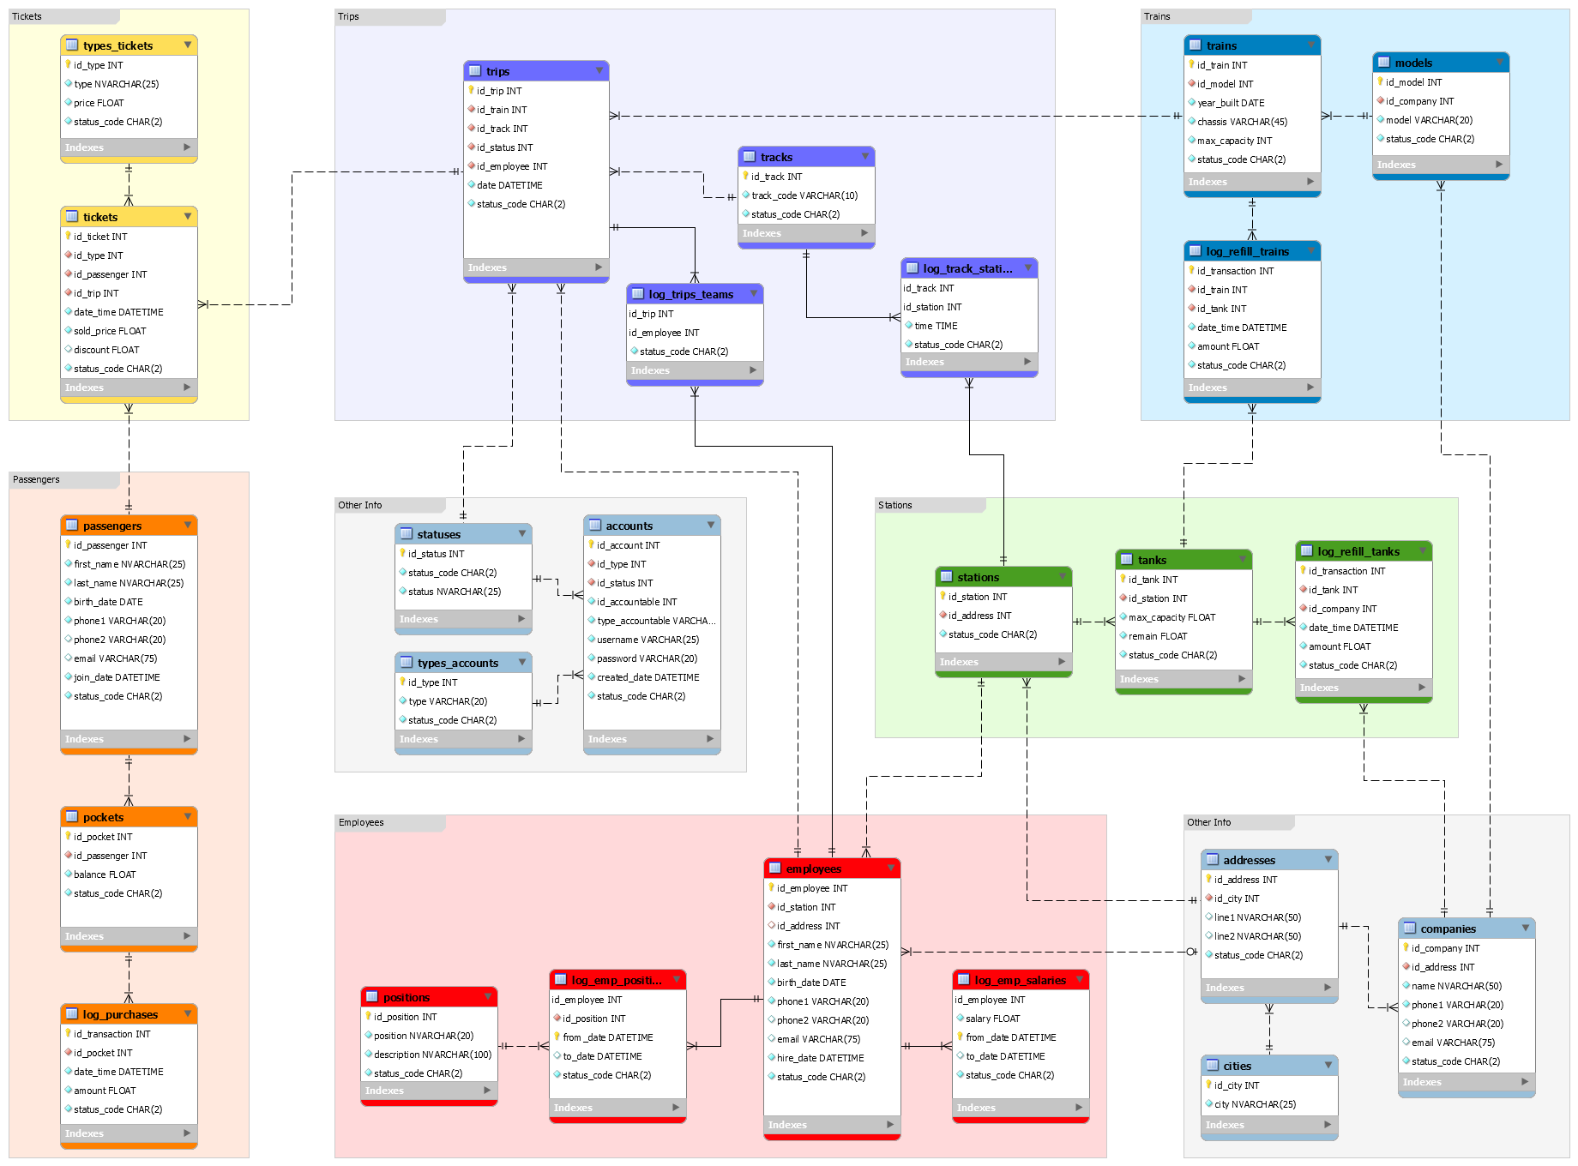
24- "Employees" and "passengers", each has an account on the system.

